Slide 1
SSS: student life and student services’ Student information system

Slide 2


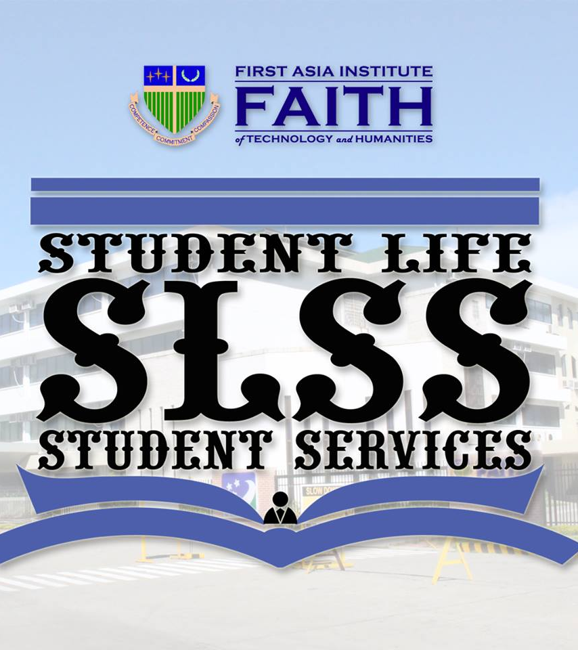
INTRODUCTION
The Student Life and Student Services of First Asia Institute of Technology and Humanities is geared towards the development of student's fullest potentials. SLSS is committed in redefining student's life by providing well-rounded activities that will foster lifelong learning and holistic development. And in order to make these objectives possible, SLSS always wants to make sure that they are updated in each student’s information for them to be able to know the standing and concerns to focus.

Slide 3
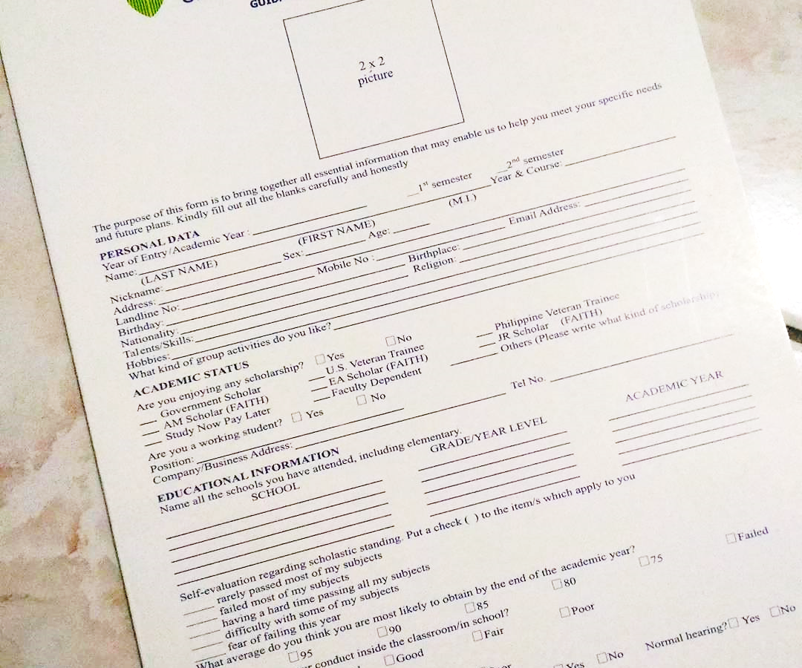
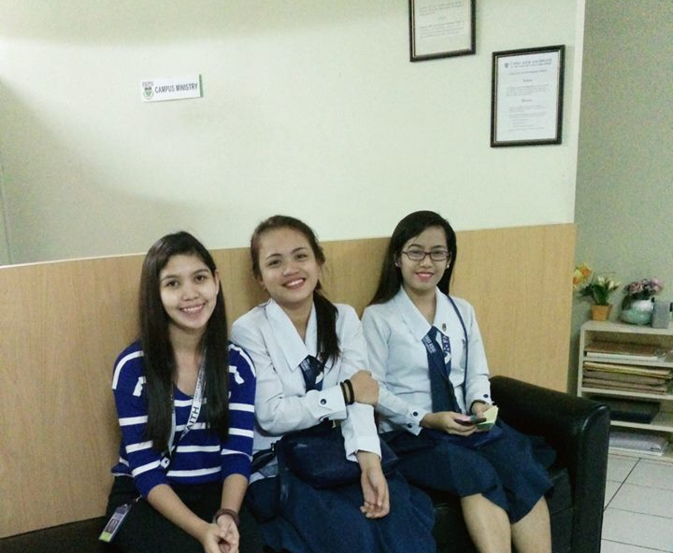
They provide student application form to every students which serves as the student information record. The student information record plays a significant role in implementing SLSS’ objectives to it’s student. Through student record, SLSS were able to track the development and improvement of the student, backgrounds and even personal concerns like family matters.

Slide 4
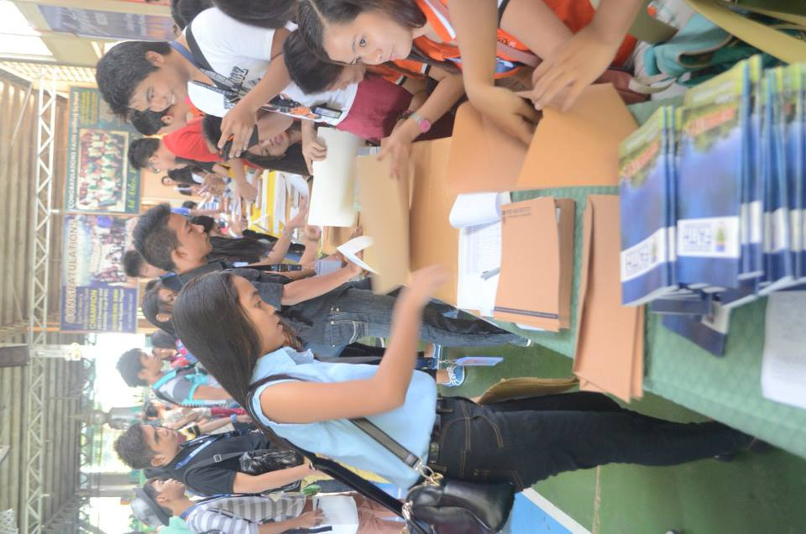
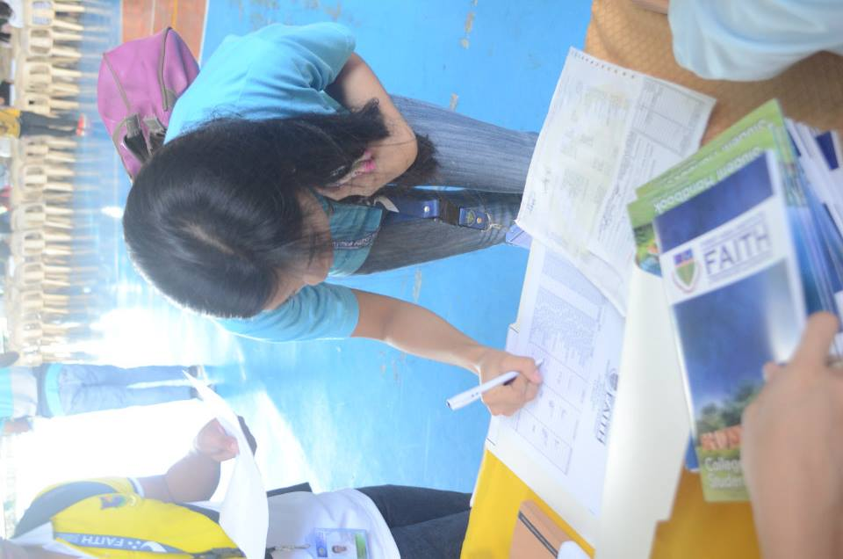
STATEMENT OF THE problem
As the student population grows in FAITH, numerous book of records are getting harder to handle by the SLSS personnel.
Outdated student record misleads SLSS basis of activities to perform.
Manual filtering of student contents took a lot of time and effort to the SLSS personnel.
In some possible cases, losing a record is one of their avoided problem.

Slide 5
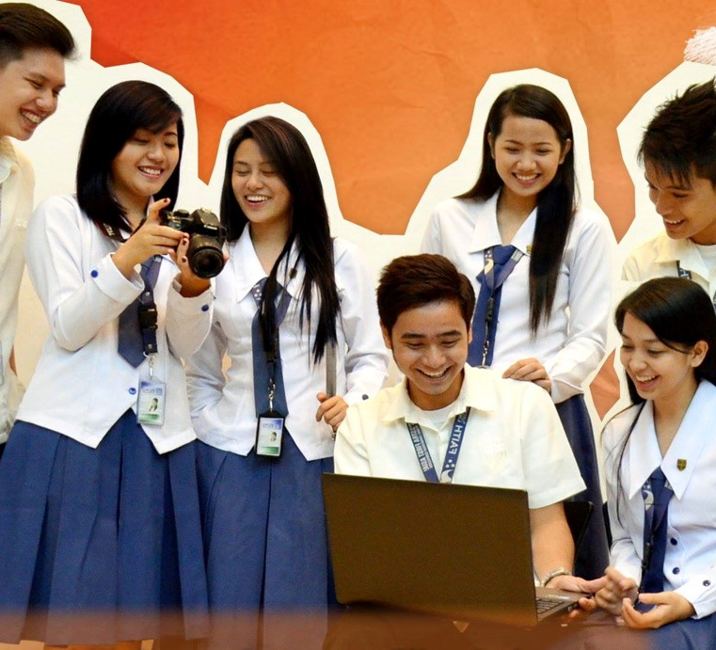
OBJECTIVES
To amend the student information and records into a web based application.
To lessen unexpected human errors and have a least amount of work to the users (Student and Admin).
To provide organization and efficiency in managing student information that would help the current system to be more productive and improved.

Slide 6
Details of the project
Sss is a student information system which provides the functionality to maintain a wide range of student data, including personal information, psychological health condition, course, and school life status.
sss offers two interfaces for accessing the information it contains: student and slss personnel. Typically, each is accessed by different subsets of people within the faith community.
Student/ admin dashboards is a user-friendly and service-based interface that is used by students and slss personnel when looking up and maintaining basic psychological health and personal information, etc. sss : admin dashboard is used by slss assigned personnel, as well, because of its ease of use.
sss Forms is used solely by student and slss personnel to manage all aspects of a student’s life, including such needed processes/services.
Notes:
Before stating its significance, let us first know some details about the project for us to understand the impact or help of this to the current process.

Slide 7
SIGNIFICANCE OF THE STUDY
SLSS
It will be easier for them to be keep in touch with the students.
Determining the needs and updates of the students to be focused on is now facile.
A manual updating of student records and filtering of desirable content is at ease.
STUDENTS
It will be easier for them to update their record without setting an appointment or schedule just to apprise.
Can be access anywhere, anytime.

Slide 8
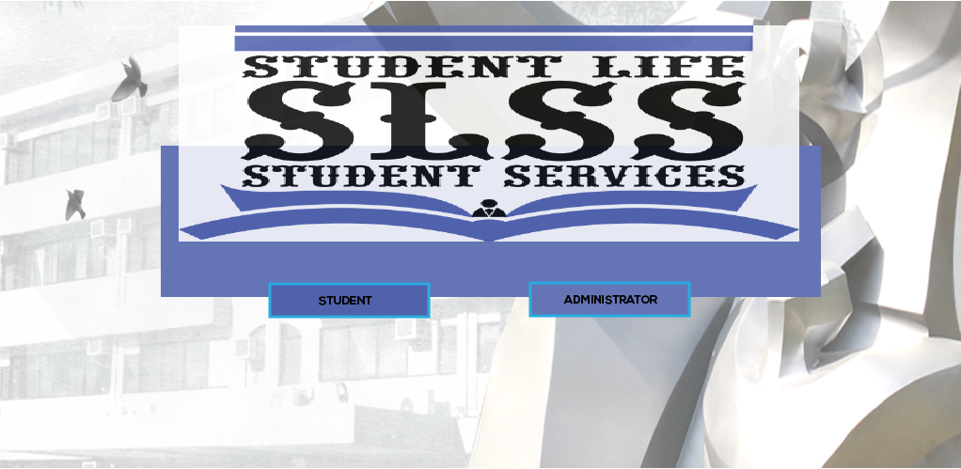
LANDING PAGE
Notes:
SLSS offers two interfaces for accessing the information it contains: Student/SLSS. Typically, each is accessed by different subsets of people within the FAITH Community.

Slide 9
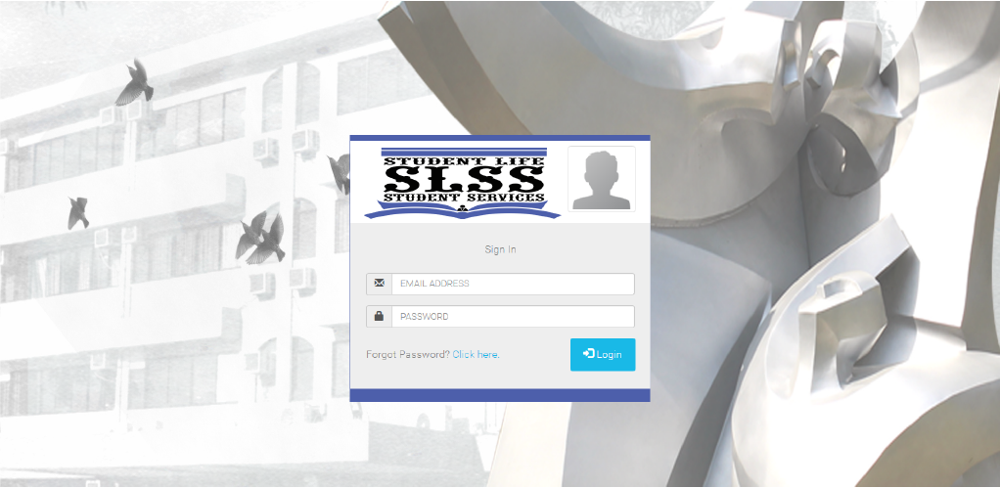
LOG IN FORM
(Student/Staff)
Notes:
A student or a SLSS personnel have an access to be able to log in to their respective dashboards

Slide 10
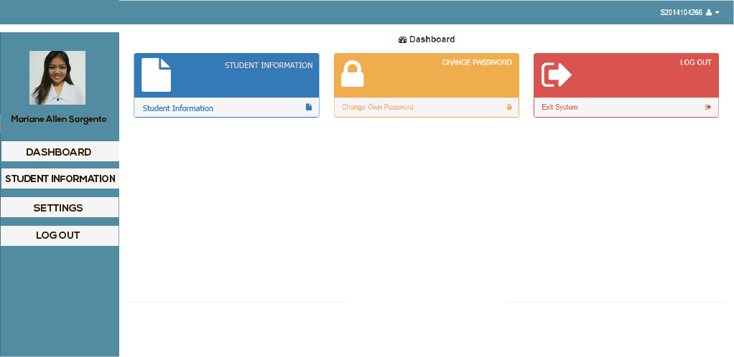
student
Notes:
This is the student dashboard looks like. It basically as same as the student portal but with differ functions or purpose.

Slide 11
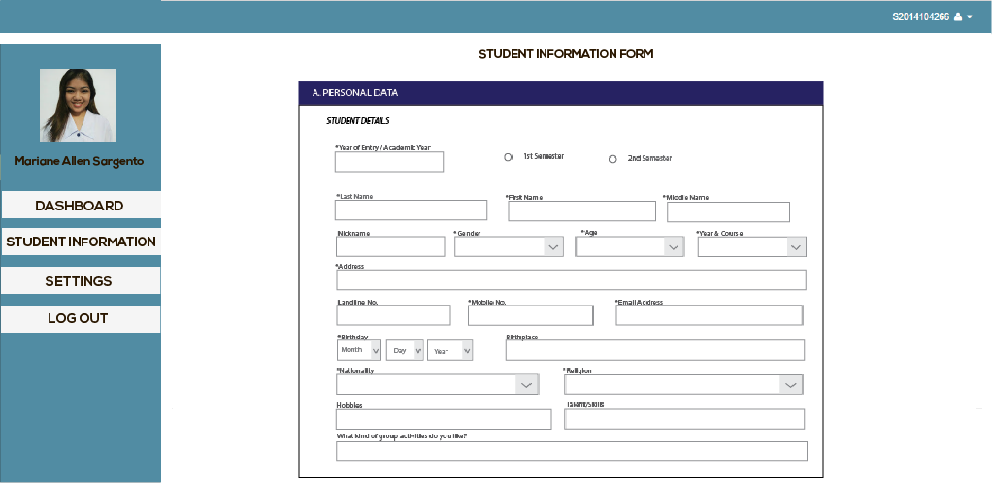
student
Notes:
This area is the student information form where students can easily update their status and concerns.

Slide 12
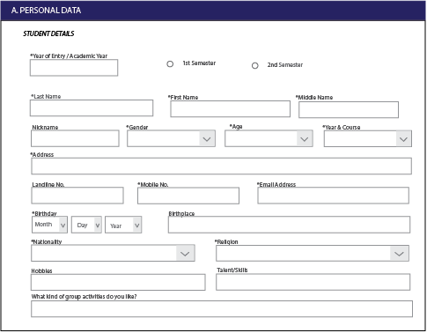
Notes:
Closer look. This is the category “A” . There are 14 category so it means, its up to “M”.

Slide 13
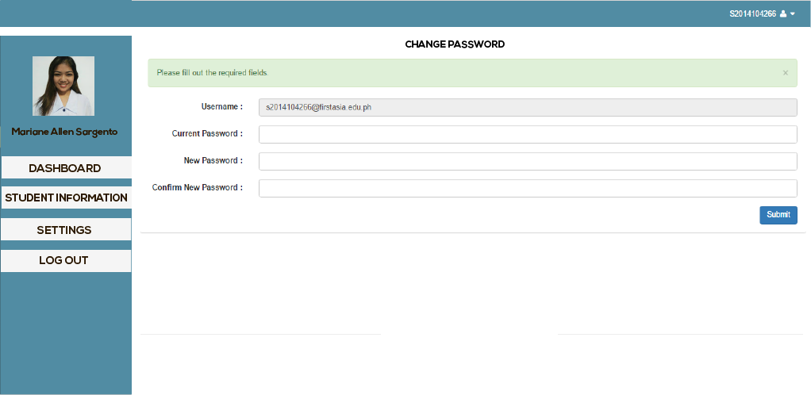
student
Notes:
Students also has the right to change password.

Slide 14
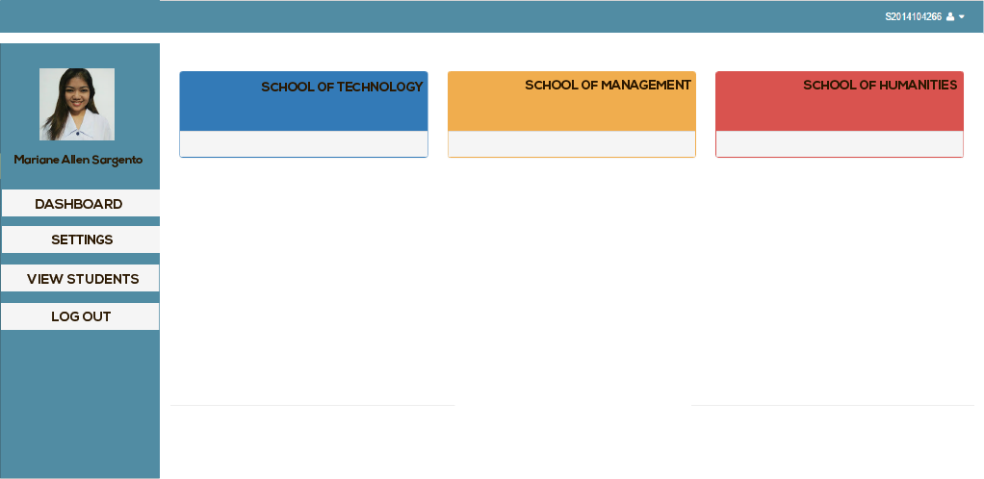
ADMIN
Notes:
For the admins dashboard, the students are categorize in their respective schools. As you can see, we have clasified the FAITH student community into three. Inside each categories are the list of student under it.

Slide 15
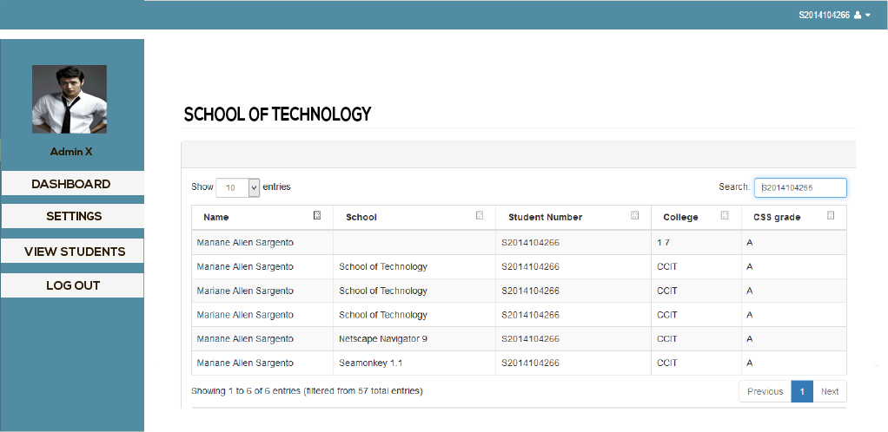
ADMIN
Notes:
This is the sample. All of the student information are synced. It also have a search bar to be able to easily find what is wanted. And once a specific student is needed… it will appear like this. (nextpage)

Slide 16
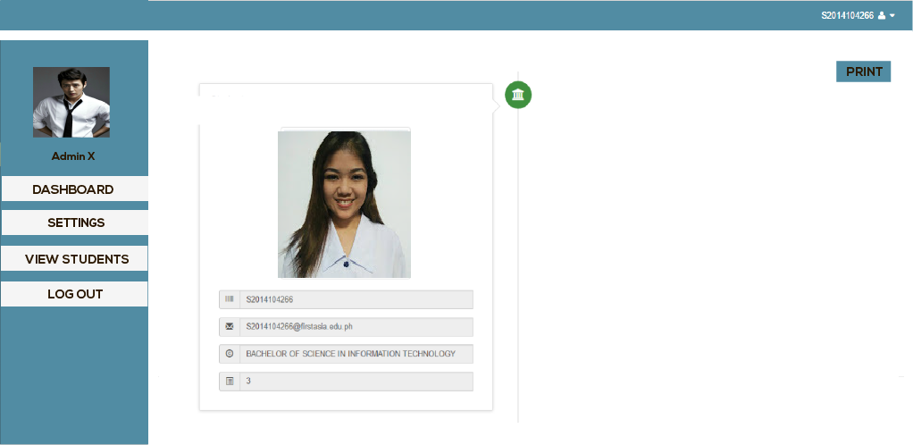
ADMIN
Notes:
Like this…

Slide 17
THANK YOU!
T E C H K N I G H T S

